Slide 1
01 - Intro to Python
Machine Learning

Slide 2
Course Overview:
1.1 - Python Review
1.2 - Numpy
1.3 - Pandas
1.4 - Seaborn
2.1 - ML Intro
2.2 - Linear Regression
2.3 - Logistic Regression
2.4 -Naïve Bayes Classifier
2.5 - KNN
2.6 - Decision Trees
3.1 – Ensembling Learning
3.2 - Neural Networks
4.* - Natural Language Processing (NLP)
5.* Competition Tips & Final Thoughts

Slide 3
Course Overview:
1.1 - Python Review
1.2 - Numpy
1.3 - Pandas
1.4 - Seaborn
2.1 - ML Intro
2.2 - Linear Regression
2.3 - Logistic Regression
2.4 - K-NN
2.5 - Decision Trees
2.6 - Neural Networks
3.1 – Ensembling Learning
3.2 Competition Tips & Final Thoughts
4.* - Natural Language Processing (NLP)

Slide 4
INTRODUCTION
01
VARIABLES/DATA TYPES
02
LIST ACCESSION
LOOPS/CONDITIONALS
TABLE OF CONTENTS
04
03
LIST COMPREHENSION
05
FUNCTIONS/LAMBDA
06
A small history of Python as a language and why it is so important.
A short description of variables and types of variables
Lists and how to access elements of a list
Types of loops and basic logical statements
How to create lists with one line of code
How to create functions and how to compress them into a single line expression

Slide 5
01
INTRODUCTION

Slide 6

What is Python?
Popular language created for simplicity and readability
Case and indent sensitive
Source: Wikimedia Commons

Slide 7
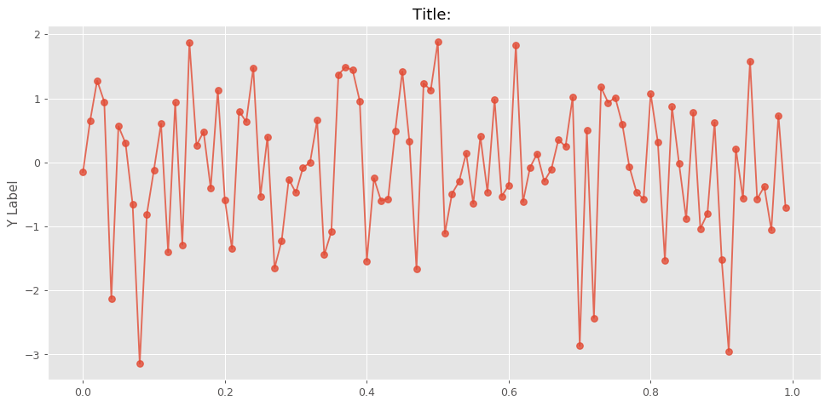
Importance
Good for data-usage, visualization, and science
Source: Maker Portal

Slide 8
02
VARIABLES/DATA TYPES

Slide 9
Basic Data Types
Booleans
Float
Integers
String
Returns a truth value.
True or False
A decimal number.
Even a regular number with a decimal is a float.
Regular numbers.
No decimals, can be positive or negative
Line of text
Set off by single quotes or double quotes.

Slide 10
Data Conversion Functions
bool()
Turns a variable into a Boolean value
Float()
Turns a variable into a float (cannot work with letters)
Str()
Turns a variable into a string
Int()
Turns a variable into an integer (cannot work with letters or a float with a decimal value)

Slide 11
Applications of conversion
Input function
Type function
Use input() to take an input from the user.
Since it is by default a string, you can use float() or int() to convert to a data type of your choice.
Use type() to check the datatype of any variable

Slide 12
03
LOOPS / CONDITIONAL STATEMENTS

Slide 13
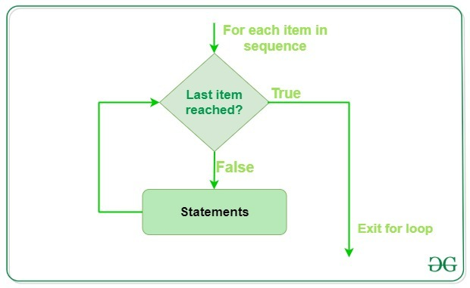
Basics
A loop is a repeated piece of code, usually until a variable meets a condition or a certain amount of iterations.
Source: Geeks for Geeks

Slide 14
While Loops
Syntax:
while [condition]:
[action]
[update condition]
Until the condition is met, the action will keep repeating.

Slide 15
For Loops
Syntax:
for [variable] in range([count)]:
[repetitive action]
Note: variable automatically updates
Range(x) - cycles through the numbers from 0 to x-1

Slide 16
If - Else Statements
Syntax:
If [condition]:
[action]
elif [condition]:
[action]
else:
[action]
Conditions can be equality (==), greater than (<), less than (>), and much more.

Slide 17
04
LISTS - BASICS, ACCESSION

Slide 18
Lists and Tuples - Basics
Tuples - set of two values or more enclosed by parentheses (ex: (0,1))
Lists - set of multiple values enclosed by brackets (ex: [1,2,3,4,5,6,7])
Tuples and Lists can be held by one variable!

Slide 19
Lists
Another type of variable/data
Important in basic python because it holds multiple values with one variable
Important for keeping track of inputs or creating rudimentary datasets
Other data types like arrays and series are based on it

Slide 20
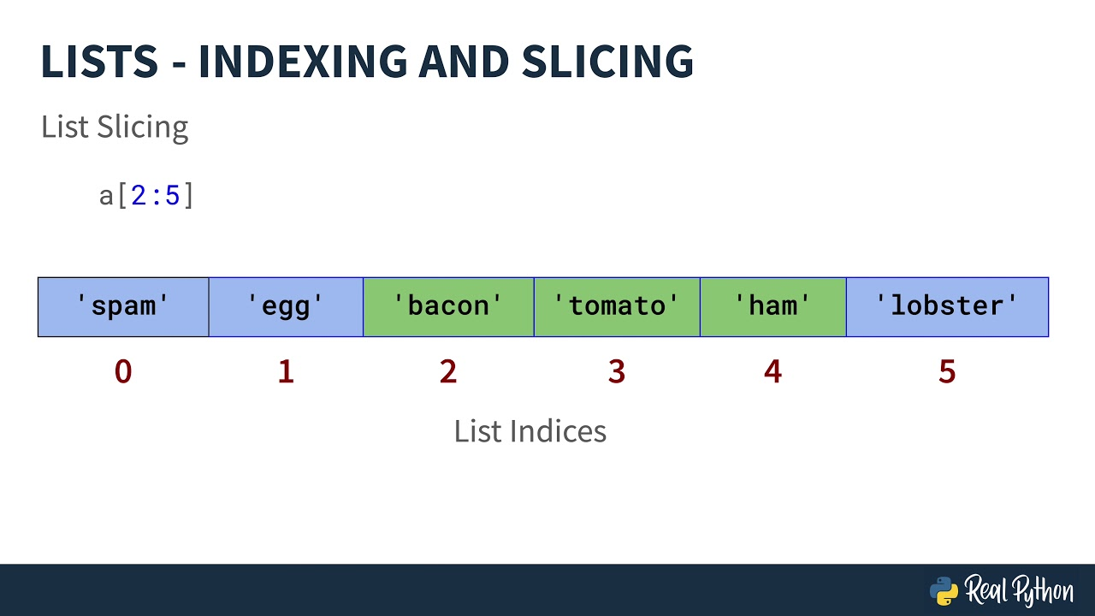
Accession: Indexing
Index: the position of a certain item in the list
Syntax: list_name[index]

Slide 21
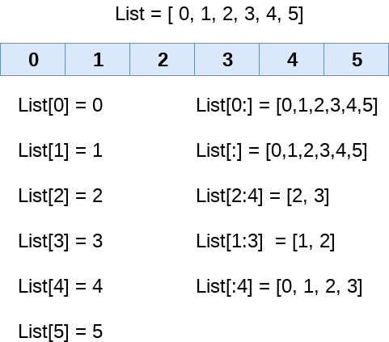
Indexing (cont.)
More syntax:

Slide 22
Basic List Functions
listname.count(item) - count the amount of times item shows up
listname.append(item) - adds the item at the end of the list
listname.remove(item) - removes item
listname.pop(index) - removes item at the specified index

Slide 23
05
LIST COMPREHENSION

Slide 24
What is list comprehension?
Creating lists in only one line!
The loops, equations, and conditions you need can be condensed into one line of code
This makes code more organized and compact!

Slide 25
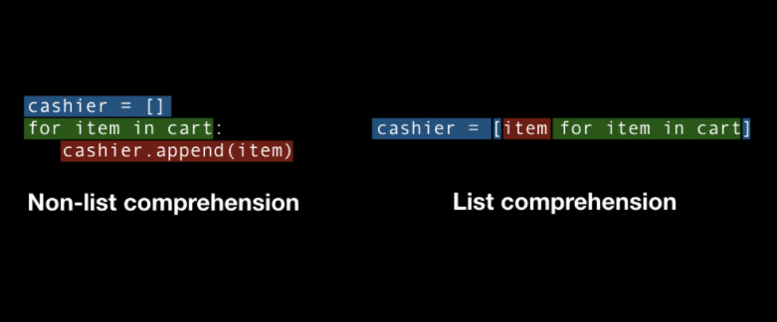
Basic Syntax
Syntax:
listname = [expression for variable in range ([range])]
Ex: numbers = [a for a in range(1,6)] #gets the numbers from 1 to 5
The list gets saved in the ‘numbers’ variable
Source: Towards Data Science

Slide 26
More examples!
Using an if statement:
even_numbers = [i for i in range (1,10) if i%2==0]
Using an if else statement to determine the expression:
even_or_odd= ["Even" if i%2==0 else "Odd" for i in range(10)]

Slide 27
06
FUNCTIONS AND LAMBDA

Slide 28
Functions
block of code specified under one name (like variable) that runs when you call the name

Slide 29
Basic Syntax and Outputs
Basic syntax:
def name (parameters):
[code]
return [value] (optional!)
When calling a function to use it:
name(arguments)
Notes:
Note: a parameter is the variable name used INSIDE the function (using the letter ‘x’ to denote input) while an argument is the ACTUAL input that gets passed to the parameter (using the input function and getting a number (y) that you use)

Slide 30
Lambda Functions
Lambda [expression]: [equation/manipulation]
Example:
lambda x : x+2
Lambda functions are a great way to condense functions into one line.

Slide 31
Thank you!

